Slide 1
创世记查经_9
【创Genesis 5:1-32】
1亚当的后代记在下面。当 神造人的日子，是照着自己的样式造的；
This is the book of the genealogy of Adam. In the day that God created man, He made him in the likeness of God.
2并且造男造女。在他们被造的日子， 神赐福给他们，称他们为人。
He created them male and female, and blessed them and called them Mankind in the day they were created.

Slide 2
创世记查经_9
【创Genesis 5:1-32】
3亚当活到一百三十岁，生了一个儿子，形像样式和自己相似，就给他起名叫塞特。
And Adam lived one hundred and thirty years, and begot a son in his own likeness, after his image, and named him Seth.
4亚当生塞特之后，又在世八百年，并且生儿养女。
After he begot Seth, the days of Adam were eight hundred years; and he had sons and daughters.

Slide 3
创世记查经_9
【创Genesis 5:1-32】
5亚当共活了九百三十岁就死了。
So all the days that Adam lived were nine hundred and thirty years; and he died.
6塞特活到一百零五岁，生了以挪士。Seth lived one hundred and five years, and begot Enosh.

Slide 4
创世记查经_9
【创Genesis 5:1-32】
7塞特生以挪士之后，又活了八百零七年，并且生儿养女。
After he begot Enosh, Seth lived eight hundred and seven years, and had sons and daughters.
8塞特共活了九百一十二岁就死了。
So all the days of Seth were nine hundred and twelve years; and he died.

Slide 5
创世记查经_9
【创Genesis 5:1-32】
9以挪士活到九十岁，生了该南。
Enosh lived ninety years, and begot Cainan.
10以挪士生该南之后，又活了八百一十五年，并且生儿养女。
After he begot Cainan, Enosh lived eight hundred and fifteen years, and had sons and daughters.

Slide 6
创世记查经_9
【创Genesis 5:1-32】
11以挪士共活了九百零五岁就死了。
So all the days of Enosh were nine hundred and five years; and he died.
12该南活到七十岁，生了玛勒列。
Cainan lived seventy years, and begot Mahalalel.

Slide 7
创世记查经_9
【创Genesis 5:1-32】
13该南生玛勒列之后，又活了八百四十年，并且生儿养女。
After he begot Mahalalel, Cainan lived eight hundred and forty years, and had sons and daughters.
14该南共活了九百一十岁就死了。
So all the days of Cainan were nine hundred and ten years; and he died.

Slide 8
创世记查经_9
【创Genesis 5:1-32】
15玛勒列活到六十五岁，生了雅列。Mahalalel lived sixty-five years, and begot Jared.
16玛勒列生雅列之后，又活了八百三十年，并且生儿养女。
After he begot Jared, Mahalalel lived eight hundred and thirty years, and had sons and daughters.

Slide 9
创世记查经_9
【创Genesis 5:1-32】
17玛勒列共活了八百九十五岁就死了。So all the days of Mahalalel were eight hundred and ninety-five years; and he died.
18雅列活到一百六十二岁，生了以诺。Jared lived one hundred and sixty-two years, and begot Enoch.

Slide 10
创世记查经_9
【创Genesis 5:1-32】
19雅列生以诺之后，又活了八百年，并且生儿养女。After he begot Enoch, Jared lived eight hundred years, and had sons and daughters.
20雅列共活了九百六十二岁就死了。So all the days of Jared were nine hundred and sixty-two years; and he died.

Slide 11
创世记查经_9
【创Genesis 5:1-32】
21以诺活到六十五岁，生了玛土撒拉。Enoch lived sixty-five years, and begot Methuselah.
22以诺生玛土撒拉之后，与 神同行三百年，并且生儿养女。After he begot Methuselah, Enoch walked with God three hundred years, and had sons and daughters.

Slide 12
创世记查经_9
【创Genesis 5:1-32】
23以诺共活了三百六十五岁。So all the days of Enoch were three hundred and sixty-five years.
24以诺与 神同行， 神将他取去，他就不在世了。And Enoch walked with God; and he was not, for God took him.

Slide 13
创世记查经_9
【创Genesis 5:1-32】
25玛土撒拉活到一百八十七岁，生了拉麦。Methuselah lived one hundred and eighty-seven years, and begot Lamech.
26玛土撒拉生拉麦之后，又活了七百八十二年，并且生儿养女。After he begot Lamech, Methuselah lived seven hundred and eighty-two years, and had sons and daughters.

Slide 14
创世记查经_9
【创Genesis 5:1-32】
27玛土撒拉共活了九百六十九岁就死了。So all the days of Methuselah were nine hundred and sixty-nine years; and he died.
28拉麦活到一百八十二岁，生了一个儿子，Lamech lived one hundred and eighty-two years, and had a son.

Slide 15
创世记查经_9
【创Genesis 5:1-32】
29给他起名叫挪亚，说：“这个儿子必为我们的操作和手中的劳苦安慰我们。这操作劳苦是因为耶和华咒诅地。”
And he called his name Noah, saying, "This one will comfort us concerning our work and the toil of our hands, because of the ground which the LORD has cursed."
30拉麦生挪亚之后，又活了五百九十五年，并且生儿养女。
After he begot Noah, Lamech lived five hundred and ninety-five years, and had sons and daughters.

Slide 16
创世记查经_9
【创Genesis 5:1-32】
31拉麦共活了七百七十七岁就死了。So all the days of Lamech were seven hundred and seventy-seven years; and he died.
32挪亚五百岁生了闪、含、雅弗。
And Noah was five hundred years old, and Noah begot Shem, Ham, and Japheth.

Slide 17
创世记查经_9
● 回顾：创世记第四章
该隐离开神的面之后建造了一座城，以他的儿子以诺的名字来命名这座城。以诺有“开始的”意思。该隐的后代越来越远离神，创世纪第四章就记载了该隐后裔的家谱。在第4章要结束的时候，上帝又赐给亚当一个孩子来代替那个被该隐杀死的儿子亚伯，这个孩子的名字叫赛特。

Slide 18
创世记查经_9
● 神按自己的形象造人
【创Genesis 5:1-2】
1亚当的后代记在下面。当 神造人的日子，是照着自己的样式造的；
This is the book of the genealogy of Adam. In the day that God created man, He made him in the likeness of God.
2并且造男造女。在他们被造的日子， 神赐福给他们，称他们为人。
He created them male and female, and blessed them and called them Mankind in the day they were created.

Slide 19
创世记查经_9
● 人的寿命
创世纪第5章列举中的赛特的后裔的平均年龄是912岁。
  *玛土撒拉
赛特的后裔当中有一个叫“玛土撒拉”的，玛土撒拉活了969岁，死于洪水当年（其名字的含义是“他死时即有审判”）。

Slide 20
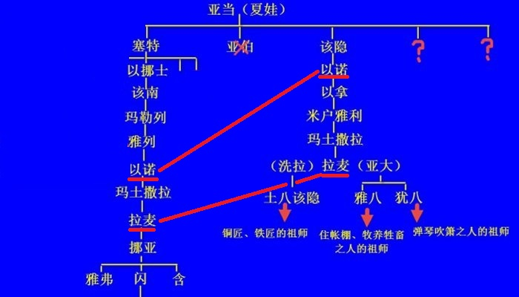

Slide 21
创世记查经_9
● 两个以诺
> 该隐的儿子以诺（第一座城市的名字）
> 赛特的后裔以诺（与神共行，被神取去）

Slide 22
创世记查经_9
● 两个拉麦
> 该隐的后裔拉麦（残暴的“伟人”）
> 赛特的后裔拉麦（得到安慰）
> 残暴拉麦的三个“伟人”儿子
> 赛特后裔拉麦的儿子—挪亚

Slide 23
创世记查经_9
● 养育虔诚的后代
【玛拉基书Malachi 2:15】
虽然 神有灵的余力能造多人，他不是单造一人吗？为何只造一人呢？乃是祂愿人得虔诚的后裔。所以当谨守你们的心，谁也不可以诡诈待幼年所娶的妻。
But did He not make them one, Having a remnant of the Spirit? And why one? He seeks godly offspring. Therefore take heed to your spirit, And let none deal treacherously with the wife of his youth.

Slide 24
创世记查经_7 问题讨论
该隐的后裔和赛特的后裔生存在同一个世界，他们面对世界的方式有何不同？
当我想到“以诺与神同行”，我会想到些什么？

