Slide 1
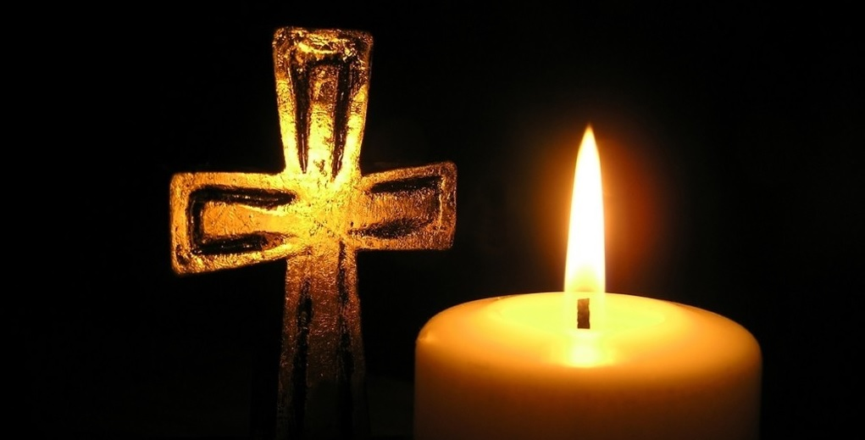
主耶稣受难日
Good Friday
2024 BCCC

Slide 2
【希伯来书 Hebrews 10:5-7】
5 所以，基督到世上来的时候，就说：“ 神啊，祭物和礼物是你不愿意的，你曾给我预备了身体，
Therefore, when He came into the world, He said: "Sacrifice and offering You did not desire, But a body You have prepared for Me.
6 燔祭和赎罪祭是你不喜欢的。
In burnt offerings and sacrifices for sin You had no pleasure.

Slide 3
【希伯来书 Hebrews 10:5-7】
7 那时我说：‘ 神啊，我来了，为要照你的旨意行，我的事在经卷上已经记载了。’”
Then I said, "Behold, I have come-- In the volume of the book it is written of Me-- To do Your will, O God."'

Slide 4
【约翰一书 1 John 4:10】
不是我们爱 神，乃是 神爱我们，差祂的儿子为我们的罪作了挽回祭，这就是爱了。
In this is love, not that we loved God, but that He loved us and sent His Son to be the propitiation for our sins.

Slide 5
【罗马书 Romans 3:23-25a】
23 因为世人都犯了罪，亏缺了 神的荣耀，
for all have sinned and fall short of the glory of God,
24 如今却蒙 神的恩典，因基督耶稣的救赎，就白白地称义。
being justified freely by His grace through the redemption that is in Christ Jesus,

Slide 6
【罗马书 Romans 3:23-25a】
25a 神设立耶稣作挽回祭，是凭着耶稣的血，藉着人的信，要显明 神的义….
whom God set forth as a propitiation by His blood, through faith, to demonstrate His righteousness, because in His forbearance God had passed over the sins that were previously committed,

Slide 7
【以赛亚书 Isaiah 53:6-10a】
6 我们都如羊走迷，各人偏行己路，耶和华使我们众人的罪孽都归在祂身上。We all, like sheep, have gone astray, each of us has turned to his own way; and the Lord has laid on him the iniquity of us all.
7 祂被欺压，在受苦的时候却不开口（或作“祂受欺压，却自卑不开口”），祂像羊羔被牵到宰杀之地，又像羊在剪毛的人手下无声，祂也是这样不开口。He was oppressed and afflicted, yet he did not open his mouth; he was led like a lamb to the slaughter, and as a sheep before her shearers is silent, so he did not open his mouth.

Slide 8
【以赛亚书 Isaiah 53:6-10a】
8 因受欺压和审判，祂被夺去，至于祂同世的人，谁想祂受鞭打、从活人之地被剪除，是因我百姓的罪过呢？By oppression and judgment he was taken away. And who can speak of his descendants? For he was cut off from the land of the living; for the transgression of my people he was stricken.
9 祂虽然未行强暴，口中也没有诡诈，人还使祂与恶人同埋；谁知死的时候与财主同葬。He was assigned a grave with the wicked, and with the rich in his death, though he had done no violence, nor was any deceit in his mouth.

Slide 9
【以赛亚书 Isaiah 53:6-10a】
10a 耶和华却定意（或作“喜悦”）将祂压伤，使祂受痛苦；耶和华以祂为赎罪祭（或作“祂献本身为赎罪祭”）……Yet it was the Lord 's will to crush him and cause him to suffer, and though the Lord makes his life a guilt offering….
【约翰一书 1 John 1:7b】
……耶稣的血也洗净我们一切的罪。
….the blood of Jesus Christ His Son cleanses us from all sin.

Slide 10
【雅各书 James 1:14-15】
14 但各人被试探，乃是被自己的私欲牵引、诱惑的。
But each one is tempted when he is drawn away by his own desires and enticed.
15 私欲既怀了胎，就生出罪来；罪既长成，就生出死来。
Then, when desire has conceived, it gives birth to sin; and sin, when it is full-grown, brings forth death.

Slide 11
【约翰福音 John 3:16】
“ 神爱世人，甚至将祂的独生子赐给他们，叫一切信祂的，不至灭亡，反得永生。
For God so loved the world that He gave His only begotten Son, that whoever believes in Him should not perish but have everlasting life.

Slide 12
【罗马书 Romans 5:7-10】
7 为义人死，是少有的；为仁人死，或者有敢作的。
For scarcely for a righteous man will one die; yet perhaps for a good man someone would even dare to die.
8 惟有基督在我们还作罪人的时候为我们死， 神的爱就在此向我们显明了。
But God demonstrates His own love toward us, in that while we were still sinners, Christ died for us.

Slide 13
【罗马书 Romans 5:7-10】
9 现在我们既靠着祂的血称义，就更要藉着祂免去 神的忿怒。
Much more then, having now been justified by His blood, we shall be saved from wrath through Him.
10 因为我们作仇敌的时候，且藉着 神儿子的死，得与 神和好；既已和好，就更要因祂的生得救了。
For if when we were enemies we were reconciled to God through the death of His Son, much more, having been reconciled, we shall be saved by His life.

Slide 14
【加拉太书 Galatians 2:20】
我已经与基督同钉十字架，现在活着的不再是我，乃是基督在我里面活着；并且我如今在肉身活着，是因信 神的儿子而活，祂是爱我，为我舍己。
I have been crucified with Christ; it is no longer I who live, but Christ lives in me; and the life which I now live in the flesh I live by faith in the Son of God, who loved me and gave Himself for me.

Slide 15
【罗马书 Romans 14:7-8】
7 我们没有一个人为自己活，也没有一个人为自己死。
For none of us lives to himself, and no one dies to himself.
8 我们若活着，是为主而活；若死了，是为主而死。所以我们或活或死，总是主的人。
For if we live, we live to the Lord; and if we die, we die to the Lord. Therefore, whether we live or die, we are the Lord’s.

Slide 16
圣餐
Holy Communion
Boise Chinese Christian Church
3/29/2024

Slide 17
【哥林多前书 1 Corinthians 11:23-29】
23 我当日传给你们的，原是从主领受的，就是主耶稣被卖的那一夜，拿起饼来，
For I received from the Lord that which I also delivered to you: that the Lord Jesus on the same night in which He was betrayed took bread;
24 祝谢了，就掰开，说:“这是我的身体，为你们舍的(“舍”有古卷作“掰开”)，你们应当如此行，为的是记念我。”
and when He had given thanks, He broke it and said, “Take, eat; this is My body which is broken for you; do this in remembrance of Me.”

Slide 18
【哥林多前书1 Corinthians 11:23-29】
25 饭后，也照样拿起杯来，说：“这杯是用我的血所立的新约。你们每逢喝的时候，要如此行，为的是记念我。”
In the same manner He also took the cup after supper, saying, “This cup is the new covenant in My blood. This do, as often as you drink it, in remembrance of Me.”
26 你们每逢吃这饼，喝这杯，是表明主的死，直等到祂来。For as often as you eat this bread and drink this cup, you proclaim the Lord’s death till He comes.

Slide 19
【哥林多前书1 Corinthians 11:23-29】
27 所以，无论何人不按理吃主的饼、喝主的杯，就是干犯主的身、主的血了。
Therefore whoever eats this bread or drinks this cup of the Lord in an unworthy manner will be guilty of the body and blood of the Lord.
28 人应当自己省察，然后吃这饼、喝这杯。
But let a man examine himself, and so let him eat of the bread and drink of the cup.

Slide 20
【哥林多前书1 Corinthians 11:23-29】
29 因为人吃喝，若不分辨是主的身体，就是吃喝自己的罪了。
For he who eats and drinks in an unworthy manner eats and drinks judgment to himself, not discerning the Lord’s body.

