Slide 1


Slide 2
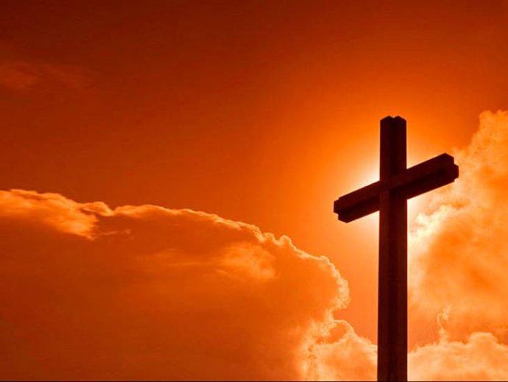
【创世记 Genesis 1:27】
神就照着自己的形像造人，乃是照着祂的形像造男造女。
So God created man in His own image; in the image of God He created him; male and female He created them.

Slide 3
【罗马书 Romans 3:23】
因为世人都犯了罪，亏缺了 神的荣耀，
for all have sinned and fall short of the glory of God,

Slide 4
【撒母耳记上 1 Samuel 16:7b】
……因为耶和华不像人看人，人是看外貌，耶和华是看内心。”
….For the Lord does not see as man sees; for man looks at the outward appearance, but the Lord looks at the heart.”
od,

Slide 5
【罗马书 Romans 1:29】
装满了各样不义、邪恶、贪婪、恶毒（或作“阴毒”），满心是嫉妒、凶杀、争竞、诡诈、毒恨，
being filled with all unrighteousness, sexual immorality, wickedness, covetousness, maliciousness; full of envy, murder, strife, deceit, evil-mindedness; they are whisperers,

Slide 6
【罗马书 Romans 3:10】
就如经上所记：“没有义人，连一个也没有；
As it is written:“There is none righteous, no, not one;

Slide 7
【雅各书 James 1:15】
私欲既怀了胎，就生出罪来；罪既长成，就生出死来。
Then, when desire has conceived, it gives birth to sin; and sin, when it is full-grown, brings forth death.

Slide 8
【希伯来书 Hebrews 9:27】
按着定命，人人都有一死，死后且有审判。
And as it is appointed for men to die once, but after this the judgment,

Slide 9
【马太福音 Matthew 1:21】
她将要生一个儿子，你要给祂起名叫耶稣，因祂要将自己的百姓从罪恶里救出来。”
And she will bring forth a Son, and you shall call His name Jesus, for He will save His people from their sins.”

Slide 10
【约翰一书 1 John 4:9】
神差祂独生子到世间来，使我们借着祂得生， 神爱我们的心在此就显明了。
This is how God showed his love among us: He sent his one and only Son into the world that we might live through him.

Slide 11
【罗马书 Romans 5:8】
惟有基督在我们还作罪人的时候为我们死， 神的爱就在此向我们显明了。
But God demonstrates his own love for us in this: While we were still sinners, Christ died for us.

Slide 12
【约翰一书 1 John 3:16a】
主为我们舍命，我们从此就知道何为爱……
By this we know love, because He laid down His life for us….

Slide 13
【约翰福音 John 3:16-18】
16 “ 神爱世人，甚至将祂的独生子赐给他们，叫一切信祂的，不至灭亡，反得永生。
For God so loved the world that He gave His only begotten Son, that whoever believes in Him should not perish but have everlasting life.

Slide 14
【启示录 Revelation 21:3-4】
3 我听见有大声音从宝座出来说：“看哪， 神的帐幕在人间。祂要与人同住，他们要作祂的子民； 神要亲自与他们同在，作他们的 神。
And I heard a loud voice from heaven saying, "Behold, the tabernacle of God is with men, and He will dwell with them, and they shall be His people. God Himself will be with them and be their God.

Slide 15
【启示录 Revelation 21:3-4】
4 神要擦去他们一切的眼泪，不再有死亡，也不再有悲哀、哭号、疼痛，因为以前的事都过去了。”
And God will wipe away every tear from their eyes; there shall be no more death, nor sorrow, nor crying. There shall be no more pain, for the former things have passed away."

