Slide 1
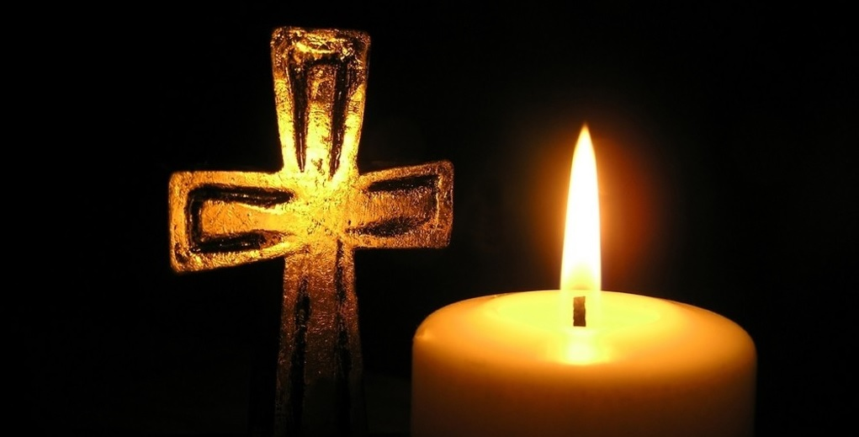
主耶稣受难日
Good Friday
2025 BCCC

Slide 2
【约翰福音 John 10:18a】
没有人夺我的命去，是我自己舍的……
No one takes it from Me, but I lay it down of Myself….
【约翰福音 John 10:11】
我是好牧人，好牧人为羊舍命。
“I am the good shepherd. The good shepherd gives His life for the sheep.

Slide 3
【马可福音 Mark 14:3-9】
3 耶稣在伯大尼长大麻风的西门家里坐席的时候，有一个女人拿着一玉瓶至贵的真哪哒香膏来，打破玉瓶，把膏浇在耶稣的头上。And being in Bethany at the house of Simon the leper, as He sat at the table, a woman came having an alabaster flask of very costly oil of spikenard. Then she broke the flask and poured it on His head.
4 有几个人心中很不喜悦，说：“何用这样枉费香膏呢？But there were some who were indignant among themselves, and said, “Why was this fragrant oil wasted?

Slide 4
【马可福音 Mark 14:3-9】
5 这香膏可以卖三十多两银子周济穷人。”他们就向那女人生气。
For it might have been sold for more than three hundred denarii and given to the poor.” And they criticized her sharply.
6 耶稣说：“由她吧！为什么难为她呢？她在我身上作的是一件美事。
But Jesus said, “Let her alone. Why do you trouble her? She has done a good work for Me.

Slide 5
【马可福音 Mark 14:3-9】
7 因为常有穷人和你们同在，要向他们行善，随时都可以；只是你们不常有我。
For you have the poor with you always, and whenever you wish you may do them good; but Me you do not have always.
8 她所作的，是尽她所能的，她是为我安葬的事，把香膏预先浇在我身上。
She has done what she could. She has come beforehand to anoint My body for burial.

Slide 6
【马可福音 Mark 14:3-9】
9 我实在告诉你们：普天之下，无论在什么地方传这福音，也要述说这女人所作的以为纪念。”
Assuredly, I say to you, wherever this gospel is preached in the whole world, what this woman has done will also be told as a memorial to her.”

Slide 7
【马可福音 Mark 14:8-9】
8 她所作的，是尽她所能的，她是为我安葬的事，把香膏预先浇在我身上。
She has done what she could. She has come beforehand to anoint My body for burial.
9 我实在告诉你们：普天之下，无论在什么地方传这福音，也要述说这女人所作的以为纪念。”
Assuredly, I say to you, wherever this gospel is preached in the whole world, what this woman has done will also be told as a memorial to her.”

Slide 8
圣餐
Holy Communion
Boise Chinese Christian Church
4/18/2025

Slide 9
【哥林多前书 1 Corinthians 11:23-29】
23 我当日传给你们的，原是从主领受的，就是主耶稣被卖的那一夜，拿起饼来，
For I received from the Lord that which I also delivered to you: that the Lord Jesus on the same night in which He was betrayed took bread;
24 祝谢了，就掰开，说:“这是我的身体，为你们舍的(“舍”有古卷作“掰开”)，你们应当如此行，为的是记念我。”
and when He had given thanks, He broke it and said, “Take, eat; this is My body which is broken for you; do this in remembrance of Me.”

Slide 10
【哥林多前书1 Corinthians 11:23-29】
25 饭后，也照样拿起杯来，说：“这杯是用我的血所立的新约。你们每逢喝的时候，要如此行，为的是记念我。”
In the same manner He also took the cup after supper, saying, “This cup is the new covenant in My blood. This do, as often as you drink it, in remembrance of Me.”
26 你们每逢吃这饼，喝这杯，是表明主的死，直等到祂来。For as often as you eat this bread and drink this cup, you proclaim the Lord’s death till He comes.

Slide 11
【哥林多前书1 Corinthians 11:23-29】
27 所以，无论何人不按理吃主的饼、喝主的杯，就是干犯主的身、主的血了。
Therefore whoever eats this bread or drinks this cup of the Lord in an unworthy manner will be guilty of the body and blood of the Lord.
28 人应当自己省察，然后吃这饼、喝这杯。
But let a man examine himself, and so let him eat of the bread and drink of the cup.

Slide 12
【哥林多前书1 Corinthians 11:23-29】
29 因为人吃喝，若不分辨是主的身体，就是吃喝自己的罪了。
For he who eats and drinks in an unworthy manner eats and drinks judgment to himself, not discerning the Lord’s body.

