Slide 1
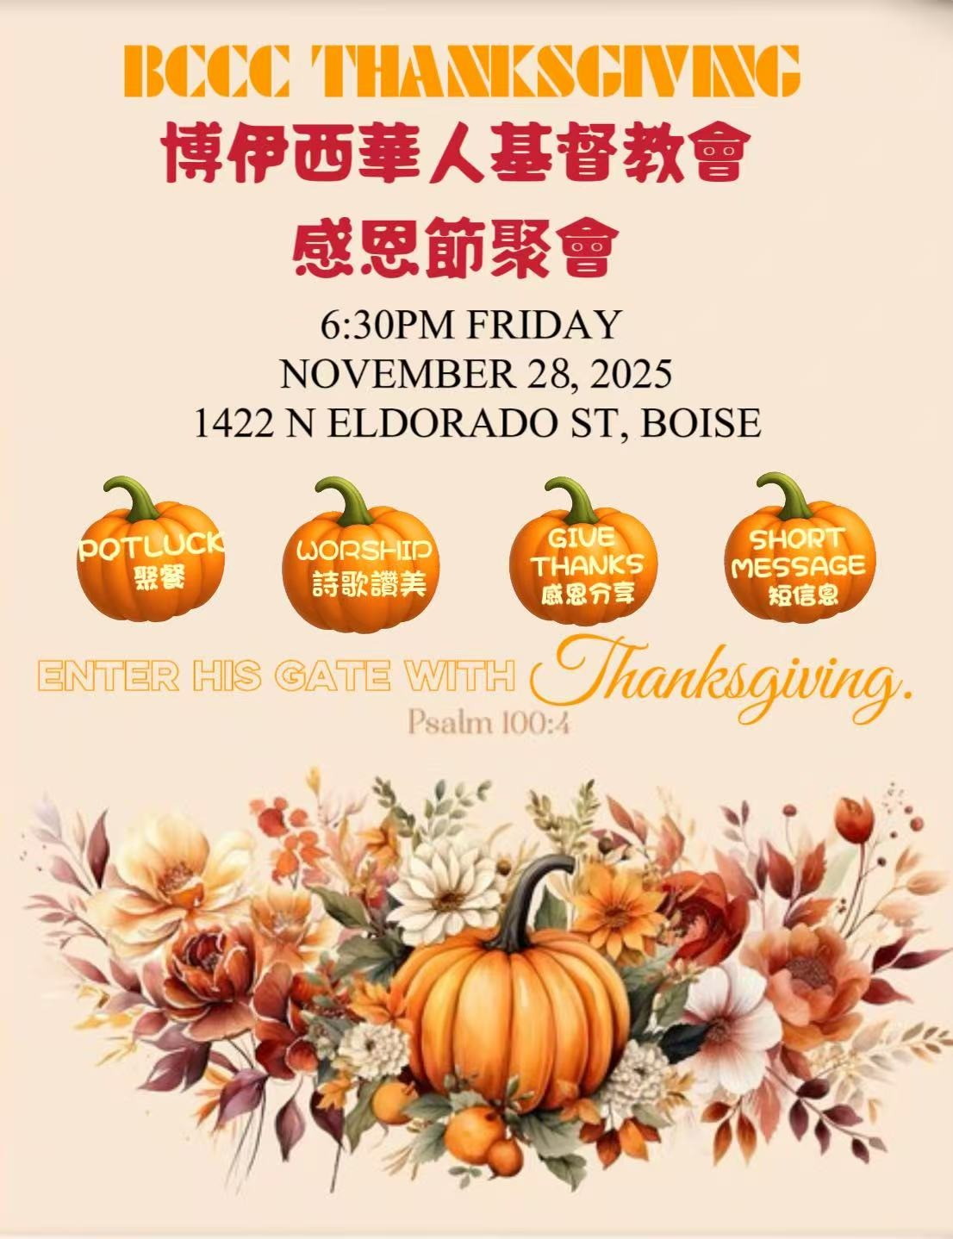

Slide 2
感恩节聚会
11/28/2025

Slide 3
“凡事谢恩，因为这是神在基督耶稣里向你们所定的旨意。”
(帖撒罗尼迦前书 5:18)
In everything give praise: for this is the purpose of God in Christ Jesus for you.
“当称谢进入他的门，当赞美进入他的院;当感谢他，称颂他的名。”
（诗篇 100:4）
Come into his doors with joy, and into his house with praise; give him honour, blessing his name.

Slide 4
诗歌

Slide 5
奇异恩典

Slide 6
奇異恩典，何等甘甜，我罪已得赦免；
前我失喪，今被尋回，瞎眼今得看見。
Amazing grace, how sweet the sound； That saved a wretch like me.
I once was lost, but now I'm found; Was blind, but now I see.
1/4

Slide 7
如此恩典，使我敬畏，使我心得安慰；
初信之時，即蒙恩惠，真是何等寶貴！
'Twas grace that taught my heart to fear, And grace my fears relieved;
How precious did that grace appear; The hour I first believed.
2/4

Slide 8
許多危險，試煉網羅，我已安然經過；
靠主恩典，安全不怕，更引導我歸家。
Through many dangers, toils, and snares, I have already come;
'Twas grace that brought me safe thus far, And grace will lead me home.
3/4

Slide 9
將來禧年，聖徒歡聚，恩光愛誼千年；
喜樂頌讚，在父座前，深望那日快現。
How sweet the name of Jesus sounds; In a believer's ear;
It soothes his sorrows, heals his wounds, And drives away his fear.
4/4

Slide 10
献上感恩的心

Slide 11
獻上感恩的心，歸給至聖全能神；因祂賜下獨生子主耶穌基督。
獻上感恩的心，歸給至聖全能神；因祂賜下獨生子主耶穌基督。
如今軟弱者已得剛強，貧窮者已成富足，
都因為主已成就了大事。
如今軟弱者能變剛強，貧窮者成為富足，
都因為主已成就了大事。
1/2

Slide 12
獻上感恩的心，歸給至聖全能神；因祂賜下獨生子主耶穌基督。
獻上感恩的心，歸給至聖全能神；因祂賜下獨生子主耶穌基督。
如今軟弱者已得剛強，貧窮者已成富足，
都因為主已成就了大事。
如今軟弱者能變剛強，貧窮者成為富足，
都因為主已成就了大事。
感恩，感恩，感---恩。
2/2

Slide 13
成为我异象

Slide 14
求我心中王 成为我异象
我别无爱慕 倠主我景仰
充满我思想 我心向往
睡着或睡醒 慈容是我光
Be Thou my vision, O Lord of my heart
Naught be all else to me, save that Thou art
Thou my best thought, by day or by night
Waking or sleeping, Thy presence my light
1/4

Slide 15
成为我智慧 成为我箴言
我愿常跟随 祢在我身边
祢是我天父 我是祢子
祢常居我心 我与祢合一
Be Thou my wisdom, and Thou my true word
I ever with Thee and Thou with me, Lord
Thou my great Father, and I Thy true son
Thou in me dwelling and I with Thee one
2/4

Slide 16
我不求虚名 也不求富有
祢是我基业 从今到永久
倠祢在我心 永远居首
天上大君王 祢是我万有
Riches I heed not, nor vain, empty praise
Thou mine inheritance, now and always
Thou and Thou only first in my heart
High King of heaven, my treasure Thou art
3/4

Slide 17
天上大君王 光明的太阳
容我享天乐 我已打胜仗
我心属祢心 永无变更
万有的主宰 成为我异象
High King of heaven, my victory won
May I reach heaven’s joys, O bright heaven’s sun
Heart of my own heart, whatever befall
Still be my vision, O ruler of all
4/4

Slide 18
见证分享

Slide 19
2025感恩节短讲

Slide 20

2025 BCCC

Slide 21
【约翰一书 1 John 3:16a】
主为我们舍命，我们从此就知道何为爱……
By this we know love, because He laid down His life for us….
【罗马书 Romans 5:8】
惟有基督在我们还作罪人的时候为我们死， 神的爱就在此向我们显明了。
But God demonstrates His own love toward us, in that while we were still sinners, Christ died for us.

Slide 22
【约翰福音 John 3:16】
神爱世人，甚至将祂的独生子赐给他们，叫一切信祂的，不至灭亡，反得永生。
For God so loved the world, that He gave His only begotten Son, that whoever believes in Him shall not perish, but have eternal life.

Slide 23
感恩在心，荣耀归主

