Slide 1
基督徒怎样面对今生的死亡？
➢ 基督徒依然不能避免今生的死亡（以下简称为“死亡”）【彼后33:10-13】
➢ 基督徒的成圣与死亡
【启 2:10c】【罗 8:28】【腓 3:10】【林前 15:25-26】
➢ 基督徒顺服神比保全自己地上的生命更重要
【启12：11】
➢ 基督徒面对自己的死亡
➢ 基督徒面对信主的基督徒亲友的死亡
➢ 基督徒面对不信之人的死亡

Slide 2


Slide 3


博伊西华人基督教会
Boise Chinese Christian Church
12/31/2023
主日崇拜
Sunday Worship
你当预备迎见你的神！ -- 阿摩司书4:12
Prepare to meet Thy God! --Amos 4:12
崇拜时，请将手机关闭或调至静音, 或将zoom的麦克风静音！
During worship, please silence your phone，
or mute your mic in zoom.

Slide 4
詩篇 Psalm 100:1-5
¹ 普天下當向耶和華歡呼！
¹ Shout for joy to the Lord, all the earth.

Slide 5
詩篇 Psalm 100:1-5
² 你們當樂意事奉耶和華，當來向他歌唱！
² Worship the Lord with gladness;
come before him with joyful songs.

Slide 6
詩篇 Psalm 100:1-5
³ 你們當曉得耶和華是神！我們是他造的，也是屬他的；我們是他的民，也是他草場的羊。
³ Know that the Lord is God.
It is he who made us, and we are his;
we are his people, the sheep of his pasture.

Slide 7
詩篇 Psalm 100:1-5
⁴ 當稱謝進入他的門；當讚美進入他的院。當感謝他，稱頌他的名！
⁴ Enter his gates with thanksgiving
and his courts with praise;
give thanks to him and praise his name.

Slide 8
詩篇 Psalm 100:1-5
⁵ 因為耶和華本為善。他的慈愛存到永遠；他的信實直到萬代。
⁵ For the Lord is good and his love endures forever;
his faithfulness continues through all generations.

Slide 9
【這是天父世界】
This is my Father's world
【生命聖詩 512】

Slide 10
這是天父世界，我們側耳靜聽，
宇宙唱歌，四圍響應，星辰作樂同聲。
This is my Father's world,
and to my listening ears
All nature sings, and round me rings
the music of the spheres.
這是天父世界[This is my Father's world 1/6]

Slide 11
這是天父世界，我心滿有安寧，
花草樹木，穹蒼碧海，述說天父奇能
This is my Father's world:
I rest me in the thought
Of rocks and trees, of skies and seas;
His hand the wonders wrought.
這是天父世界[This is my Father's world 2/6]

Slide 12
這是天父世界，群鳥歡唱齊鳴，
清晨明亮，百花美麗，證明創造精深。
This is my Father's world,
the birds their carols raise,
The morning light, the lily white,
declare their Maker's praise.
這是天父世界[This is my Father's world 3/6]

Slide 13
這是天父世界，祂愛普及萬千，
風吹草聲，知祂經過，隨處能聽祂言。
This is my Father's world:
He shines in all that's fair;
In the rustling grass I hear Him pass;
He speaks to me everywhere.
這是天父世界[This is my Father's world 4/6]

Slide 14
這是天父世界，叫我不可遺忘，
黑暗勢力雖然猖狂，天父卻仍作王。
This is my Father's world.
O let me ne'er forget
That though the wrong seems oft so strong,
God is the ruler yet.
這是天父世界[This is my Father's world 5/6]

Slide 15
這是天父世界，我心不必憂傷，
天父是王，宇宙同唱，祂治萬國萬方。
This is my Father's world:
the battle is not done:
Jesus Who died shall be satisfied,
And earth and Heav'n be one.
這是天父世界[This is my Father's world 6/6]

Slide 16
【 耶穌愛我】
Jesus loves me
【生命聖詩513】

Slide 17
耶穌愛我！我知道，因有聖經告訴我，
幼小孩童祂牧養，他們軟弱主剛強。
Jesus loves me—this I know,
For the Bible tells me so:
Little ones to him belong,—
They are weak, but he is strong.
耶穌愛我 [Jesus loves me 1/8]

Slide 18
主耶穌愛我！主耶穌愛我！
主耶穌愛我，有聖經告訴我。
Yes, Jesus loves me!
Yes, Jesus loves me!
Yes, Jesus loves me!
The Bible tells me so.
耶穌愛我 [Jesus loves me 2/8]

Slide 19
耶穌愛我！永不變，雖我軟弱多疾病，
從今離罪得釋放，因主釘死十架上。
Jesus loves me—loves me still,
Though I'm very weak and ill;
From his shining throne on high,
Comes to watch me where I lie.
耶穌愛我 [Jesus loves me 3/8]

Slide 20
主耶穌愛我！主耶穌愛我！
主耶穌愛我，有聖經告訴我。
Yes, Jesus loves me!
Yes, Jesus loves me!
Yes, Jesus loves me!
The Bible tells me so.
耶穌愛我 [Jesus loves me 4/8]

Slide 21
耶穌愛我！捨生命，將我罪惡洗乾淨，
天堂恩門為我開，讓祂小孩走進來。
Jesus loves me—he who died
Heaven's gate to open wide;
He will wash away my sin,
Let his little child come in.
耶穌愛我 [Jesus loves me 5/8]

Slide 22
主耶穌愛我！主耶穌愛我！
主耶穌愛我，有聖經告訴我。
Yes, Jesus loves me!
Yes, Jesus loves me!
Yes, Jesus loves me!
The Bible tells me so.
耶穌愛我 [Jesus loves me 6/8]

Slide 23
耶穌愛我！到永遠，一生道路主陪伴，
主既為我罪捨命，活著願榮耀主名。
Jesus loves me—he will stay
Close beside me all the way.
Thou hast bled and died for me,
I will hence forth live for Thee.
耶穌愛我 [Jesus loves me 7/8]

Slide 24
主耶穌愛我！主耶穌愛我！
主耶穌愛我，有聖經告訴我。
Yes, Jesus loves me!
Yes, Jesus loves me!
Yes, Jesus loves me!
The Bible tells me so.
耶穌愛我 [Jesus loves me 8/8]

Slide 25

讓我們用禱告來尋求神！
Please stand up!
會眾請站立

Slide 26
【信靠順服】
Trust and Obey
【生命聖詩287 】

Slide 27
在主真道光中，我與救主同行，
何等榮耀照亮我路程，
When we walk with the Lord
in the light of his word,
what a glory he sheds on our way!
信靠順服 [Trust and Obey 1/12]

Slide 28
只要遵主旨意，主肯與我同行，
信靠順服，主必肯同行。
While we do his good will,
he abides with us still,
and with all who will trust and obey.
信靠順服 [Trust and Obey 2/12]

Slide 29
信靠順服，此外不能蒙福，
若要得主裏喜樂，只要信靠順服。
Trust and obey, for there's no other way
to be happy in Jesus, but to trust and obey.
信靠順服 [Trust and Obey 3/12]

Slide 30
沒有黑影遮蔽，也無雲霧迷漫，
因主笑容使雲霧消散；
Not a burden we bear,
not a sorrow we share,
but our toil he doth richly repay;
信靠順服 [Trust and Obey 4/12]

Slide 31
沒有疑惑畏懼，沒有眼淚憂慮，
信靠順服，憂懼自消除。
not a grief or a loss,
not a frown or a cross,
but is blest if we trust and obey.
信靠順服 [Trust and Obey 5/12]

Slide 32
信靠順服，此外不能蒙福，
若要得主裏喜樂，只要信靠順服。
Trust and obey, for there's no other way
to be happy in Jesus, but to trust and obey.
信靠順服 [Trust and Obey 6/12]

Slide 33
除非我將一切奉獻救主腳前，
主豐滿慈愛才能體驗；
But we never can prove
the delights of his love
until all on the altar we lay;
信靠順服 [Trust and Obey 7/12]

Slide 34
因主一切恩惠，一切喜樂榮美，
乃為信靠順服者預備。
for the favor he shows,
for the joy he bestows,
are for them who will trust and obey.
信靠順服 [Trust and Obey 8/12]

Slide 35
信靠順服，此外不能蒙福，
若要得主裏喜樂，只要信靠順服。
Trust and obey, for there's no other way
to be happy in Jesus, but to trust and obey.
信靠順服 [Trust and Obey 9/12]

Slide 36
我願在主腳前，享主團契甘甜，
行走天路常在主身邊；
Then in fellowship sweet
we will sit at his feet,
or we'll walk by his side in the way;
信靠順服 [Trust and Obey 10/12]

Slide 37
主吩咐即聽命，主差遣就遵行，
信靠順服必永無憂驚。
what he says we will do,
where he sends we will go;
never fear, only trust and obey.
信靠順服 [Trust and Obey 11/12]

Slide 38
信靠順服，此外不能蒙福，
若要得主裏喜樂，只要信靠順服。
Trust and obey, for there's no other way
to be happy in Jesus, but to trust and obey.
信靠順服 [Trust and Obey 12/12]

Slide 39

主日信息

Slide 40
门徒的喜乐
Joy of His disciples
Boise Chinese Christian Church
12/31/2023

Slide 41
【使徒行传 Acts 5:41-42】
41 他们离开公会，心里欢喜，因被算是配为这名受辱。
So they departed from the presence of the council, rejoicing that they were counted worthy to suffer shame for His name.
42 他们就每日在殿里、在家里不住地教训人，传耶稣是基督。
And daily in the temple, and in every house, they did not cease teaching and preaching Jesus as the Christ.

Slide 42
【尼希米记 Nehemiah 8:10b】
……你们不要忧愁，因靠耶和华而得的喜乐是你们的力量。”
Do not sorrow, for the joy of the Lord is your strength.”
【使徒行传 Acts 5:41】
他们离开公会，心里欢喜，因被算是配为这名受辱。
So they departed from the presence of the council, rejoicing that they were counted worthy to suffer shame for His name.

Slide 43
【使徒行传 Acts 4:13】
他们见彼得、约翰的胆量，又看出他们原是没有学问的小民，就希奇，认明他们是跟过耶稣的。
Now when they saw the boldness of Peter and John, and perceived that they were uneducated and untrained men, they marveled. And they realized that they had been with Jesus.

Slide 44
【约翰福音 John 16:24】
向来你们没有奉我的名求什么，如今你们求就必得着，叫你们的喜乐可以满足。”
Until now you have asked nothing in My name. Ask, and you will receive, that your joy may be full.

Slide 45
【列王纪下2 Kings 2:9】
过去之后，以利亚对以利沙说：“我未曾被接去离开你，你要我为你作什么，只管求我。”以利沙说：“愿感动你的灵加倍地感动我。”
And so it was, when they had crossed over, that Elijah said to Elisha, “Ask! What may I do for you, before I am taken away from you?”Elisha said, “Please let a double portion of your spirit be upon me.”

Slide 46
【约翰一书 1 John 5:14-15】
14 我们若照祂的旨意求什么，祂就听我们，这是我们向祂所存坦然无惧的心。
Now this is the confidence that we have in Him, that if we ask anything according to His will, He hears us.
15 既然知道祂听我们一切所求的，就知道我们所求于祂的，无不得着。
And if we know that He hears us, whatever we ask, we know that we have the petitions that we have asked of Him.

Slide 47
【罗马书 Romans 8:29】
因为祂预先所知道的人，就预先定下效法祂儿子的模样，使祂儿子在许多弟兄中作长子。
For whom He foreknew, He also predestined to be conformed to the image of His Son, that He might be the firstborn among many brethren.

Slide 48
【彼得前书 1 Peter 2:21】
你们蒙召原是为此，因基督也为你们受过苦，给你们留下榜样，叫你们跟随祂的脚踪行。
For to this you were called, because Christ also suffered for us, leaving us an example, that you should follow His steps:

Slide 49
【约翰福音 John 16:7-8】
7 然而我将真情告诉你们，我去是与你们有益的。我若不去，保惠师就不到你们这里来；我若去，就差祂来。
Nevertheless I tell you the truth. It is to your advantage that I go away; for if I do not go away, the Helper will not come to you; but if I depart, I will send Him to you.
8 祂既来了，就要叫世人为罪、为义、为审判，自己责备自己。
And when He has come, He will convict the world of sin, and of righteousness, and of judgment:

Slide 50
【彼得前书 1 Peter 1:3-7】
3 愿颂赞归于我们主耶稣基督的父 神，祂曾照自己的大怜悯，藉耶稣基督从死里复活，重生了我们，叫我们有活泼的盼望，
Blessed be the God and Father of our Lord Jesus Christ, who according to His abundant mercy has begotten us again to a living hope through the resurrection of Jesus Christ from the dead,
4 可以得着不能朽坏、不能玷污、不能衰残、为你们存留在天上的基业。to an inheritance incorruptible and undefiled and that does not fade away, reserved in heaven for you,

Slide 51
【彼得前书 1 Peter 1:3-7】
5 你们这因信蒙 神能力保守的人，必能得着所预备、到末世要显现的救恩。
who are kept by the power of God through faith for salvation ready to be revealed in the last time.
6 因此，你们是大有喜乐。但如今在百般的试炼中暂时忧愁，
In this you greatly rejoice, though now for a little while, if need be, you have been grieved by various trials,

Slide 52
【彼得前书 1 Peter 1:3-7】
7 叫你们的信心既被试验，就比那被火试验仍然能坏的金子更显宝贵，可以在耶稣基督显现的时候，得着称赞、荣耀、尊贵。
that the genuineness of your faith, being much more precious than gold that perishes, though it is tested by fire, may be found to praise, honor, and glory at the revelation of Jesus Christ,

Slide 53
【彼得前书 1 Peter 1:3，6a】
3 愿颂赞归于我们主耶稣基督的父 神，祂曾照自己的大怜悯，藉耶稣基督从死里复活，重生了我们，叫我们有活泼的盼望，
Blessed be the God and Father of our Lord Jesus Christ, who according to His abundant mercy has begotten us again to a living hope through the resurrection of Jesus Christ from the dead,
6a 因此，你们是大有喜乐……
In this you greatly rejoice….

Slide 54
【彼得前书 1 Peter 1:4，6a】
4 可以得着不能朽坏、不能玷污、不能衰残、为你们存留在天上的基业。
to an inheritance incorruptible and undefiled and that does not fade away, reserved in heaven for you,
6a 因此，你们是大有喜乐……
In this you greatly rejoice….

Slide 55
【彼得前书 1 Peter 1:5，6a】
5 你们这因信蒙 神能力保守的人，必能得着所预备、到末世要显现的救恩。
who are kept by the power of God through faith for salvation ready to be revealed in the last time.
6a 因此，你们是大有喜乐……
In this you greatly rejoice….

Slide 56
【使徒行传 Acts 5:41】
他们离开公会，心里欢喜，因被算是配为这名受辱。
So they departed from the presence of the council, rejoicing that they were counted worthy to suffer shame for His name.
【希伯来书 Hebrews 11:16】他们却羡慕一个更美的家乡，就是在天上的。所以 神被称为他们的 神，并不以为耻，因为祂已经给他们预备了一座城。
But now they desire a better, that is, a heavenly country. Therefore God is not ashamed to be called their God, for He has prepared a city for them.

Slide 57
【罗马书 Romans 8:16-18】
16 圣灵与我们的心同证我们是 神的儿女；
The Spirit Himself bears witness with our spirit that we are children of God,
17 既是儿女，便是后嗣，就是 神的后嗣，和基督同作后嗣。如果我们和祂一同受苦，也必和祂一同得荣耀。
and if children, then heirs—heirs of God and joint heirs with Christ, if indeed we suffer with Him, that we may also be glorified together.

Slide 58
【罗马书 Romans 8:16-18】
18 我想，现在的苦楚若比起将来要显于我们的荣耀，就不足介意了。
For I consider that the sufferings of this present time are not worthy to be compared with the glory which shall be revealed in us.

Slide 59
三一頌 Doxology
讚美真神萬福之根
世上萬民讚美主恩
天使天軍讚美主名
贊美聖父聖子聖靈 阿門
Praise God, from whom all blessings flow;
Praise Him, all creatures here below;
Praise Him above, ye heavenly host;
Praise Father, Son and Holy Ghost. Amen!

Slide 60

博伊西華人基督教會
歡迎您！

Slide 61
鼓勵大家參加教會活動：
周日上午9:30, 成人主日學: 認識神
周二上午10：00，姊妹會。姊妹会暂停两周，1月9日恢复。
周二晚上7:00, 禱告會
周五晚上7:30, 查經聚會: 士師記.
双数周六上午8:00, 弟兄早餐會
隔周周六下午3:30, 提摩太團契
We encourage everyone to participate our church’s activities: Sun 9:30am, Adult Sunday School, Knowing GOD; Tue. 10am, Sisters Fellowship, potluck followed; Fri 7:30pm Bible study, Judges; Every even Sat 8am, brother’s breakfast gathering; Every 2 Sat 3:30pm, Timothy fellowship.

Slide 62
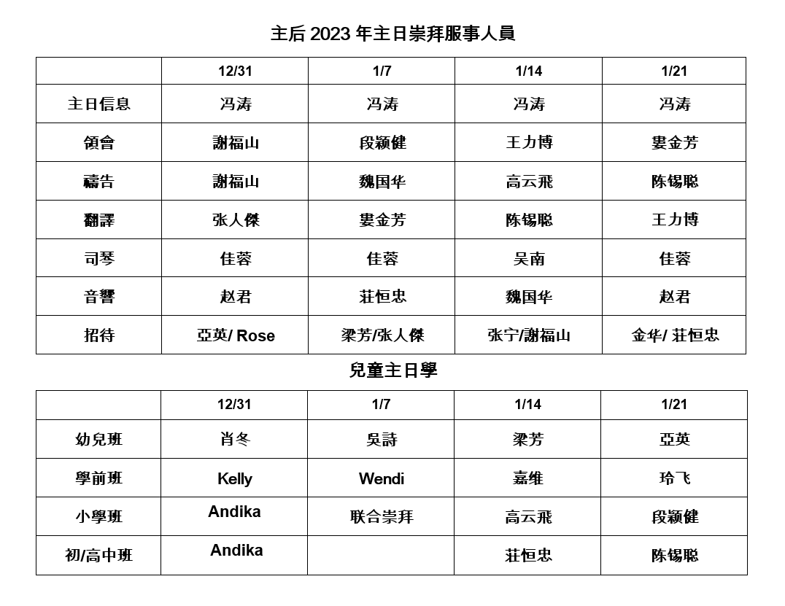

Slide 63
12/24 奉献 offering：
General: $1013
Lunch: $130

Slide 64
如果有任何奉献，请放到教会奉献箱或将
支票寄到教会邮箱。
If you have offering, please put it in the Offer Box or send the check to church’s mail.
Boise Chinese Christian Church
1422 N Eldorado St.
Boise, ID 83704

Slide 65
信仰告白
Apostle’s Creed
Boise Chinese Christian Church

Slide 66
使徒信經 Apostles' Creed
我信上帝，全能的父，創造天地的主。 我信我主耶穌基督，上帝的獨生子； 因著聖靈感孕，從童貞女馬利亞所生；在本丟彼拉多手下受難，被釘在十字架上，受死，埋葬； | I believe in God the Father, Almighty, Maker of heaven and earth: And in Jesus Christ, his only begotten Son, our Lord: Who was conceived by the Holy Ghost, born of the Virgin Mary: Suffered under Pontius Pilate; was crucified, dead and buried:

Slide 67
使徒信經 Apostles' Creed
降在陰間；第三天從死裏復活； 後升天，坐在全能父上帝的右邊； 將來必從那裏降臨，審判活人，死人。 我信聖靈； | He descended into hell; The third day he rose again from the dead: He ascended into heaven, and sits at the right hand of God the Father Almighty: From thence he shall come to judge the quick and the dead: I believe in the Holy Ghost:

Slide 68
使徒信經 Apostles' Creed
我信聖而公之教會； 我信聖徒相通； 我信罪得赦免， 我信身體復活； 我信永生。阿們！ | I believe in the holy universal church: the communion of saints: The forgiveness of sins: The resurrection of the body: And the life everlasting. Amen.

Slide 69
祝祷 Benediction
【哥林多后书13:14】 愿 主耶稣基督的恩惠、 神的慈爱、 圣灵的感动， 常与你们众人同在！ | 【2 Corinthians 13:14】 The grace of the Lord Jesus Christ, and the love of God, and the communion of the Holy Spirit be with you all. Amen.

